Slide 1
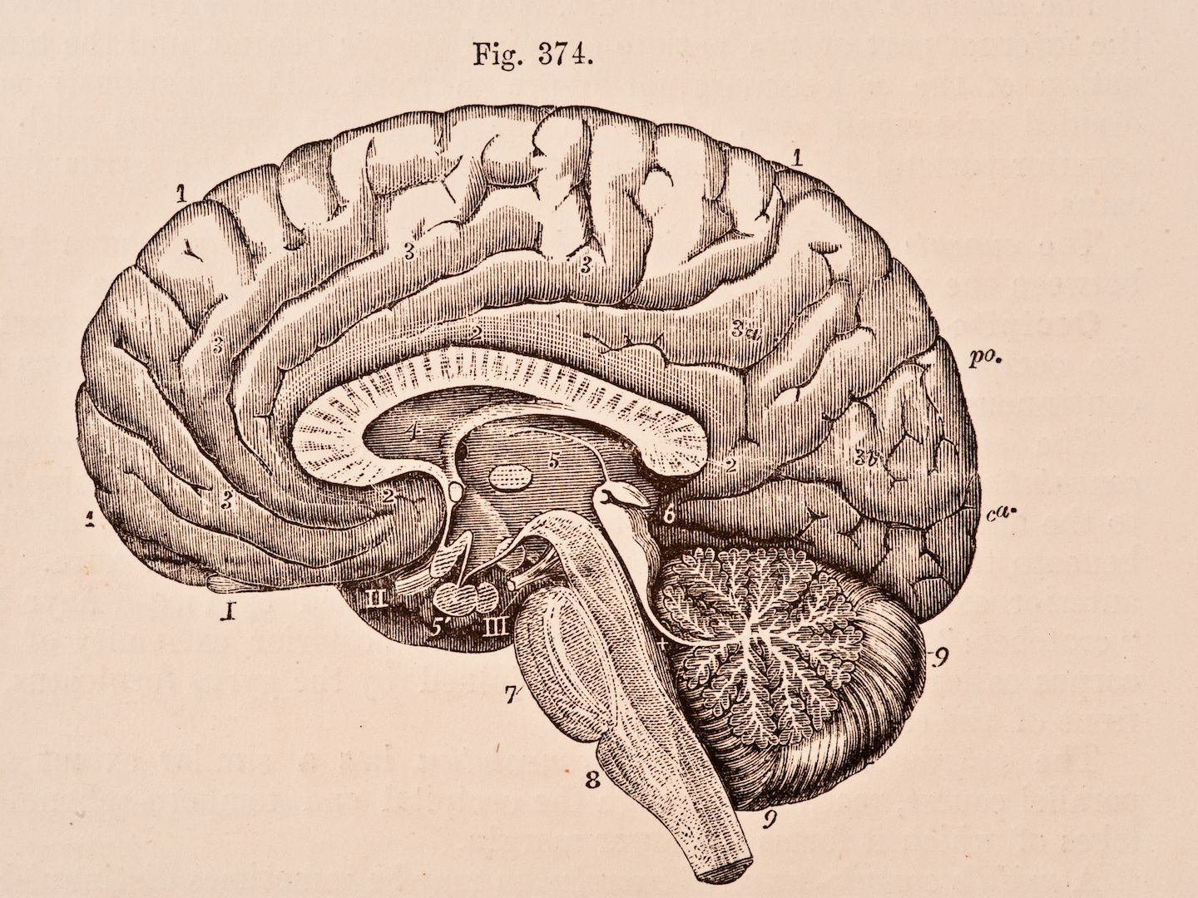
On the DMN and FMRI

Slide 2
mPFC
*FMRI is a scan that observes blood flow in the brain
0.110
-0.119
0.182
*It shows us what parts of the brain are active at the same time
PCC
0.115
0.081
0.091
*From this we can infer which segments of the brain communicate with each other and how often
0.012
0.042
RIPC
LIPC
0.274
0.274
0.031
0.030
Figure of the DMN of a healthy brain

Slide 3
mPFC
*The Default Mode Network is a section of the brain active when we aren’t doing a task
0.091
0.282
0.029
*The DMN of a person with Autism functions differently than that of a healthy human
0.152
PCC
0.191
0.334
*Some parts communicate less, while others much more
0.099
0.017
RIPC
LIPC
0.167
0.026
0.056
0.030
Figure of the DMN of a person with ASD

Slide 4
mPFC
*Using FMRI scans we can find the difference between the two
0.201
0.038
0.089
*It shows us what parts of the brain are active at the same time
PCC
0.268
0.109
0.426
*We can better understand how mental illnesses work and how we can treat them
0.029
RIPC
LIPC
0.116
0.080
0.248
0.0876
0.077
Figure of the difference between the two DMN’s

